Slide 1
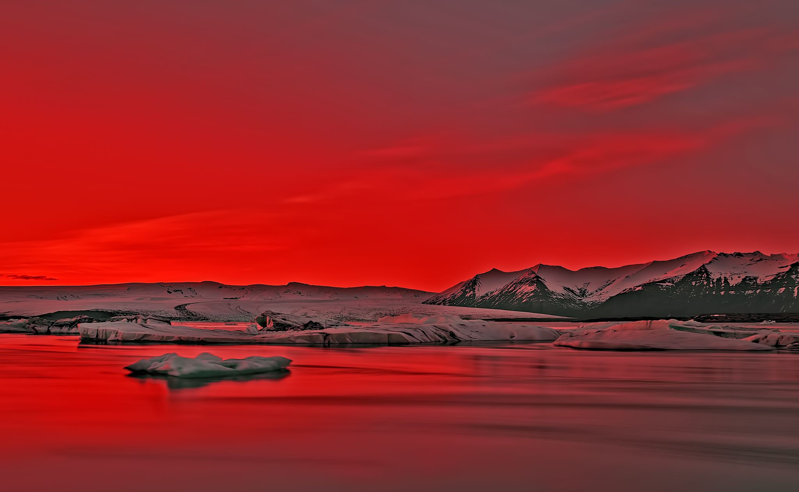
Risk Assessment: Hazardous Water Resource Area in Hawaii county, from Kilauea Volcano Eruption using 30-meter resolution LiDAR DEM’s
GEOG 3050
Final Project
Wael Alhaj

Slide 2
Introduction
Kilauea is one of the five active volcanoes on the island of Hawaii. it has been erupting continuously since 1983. On April 30,2018, the sign of eruption became more significant, the Kilauea volcano collapsed, and lava lake continues to sink down. according to TIME magazine, on May 8, 2018 President Donald Trump declared the volcanic explosion a major disaster in state of Hawaii. Fortunately, the collapse events end on August 2, 2018.

Slide 3
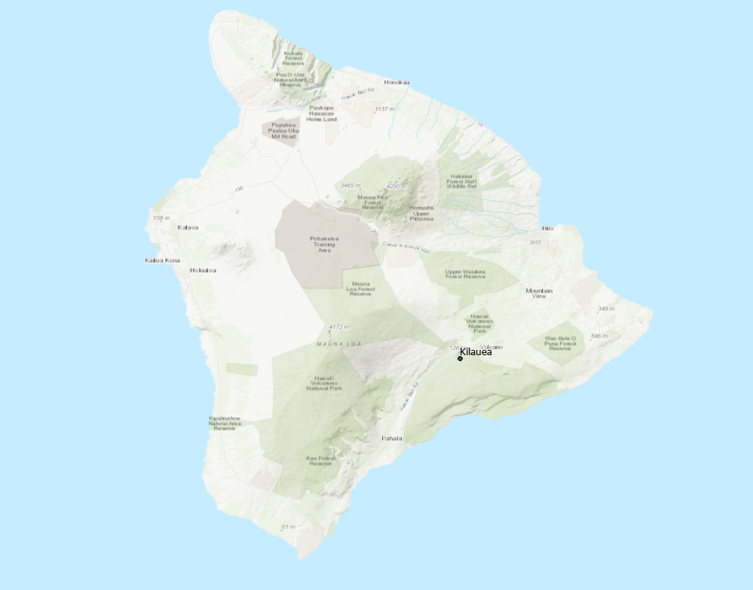
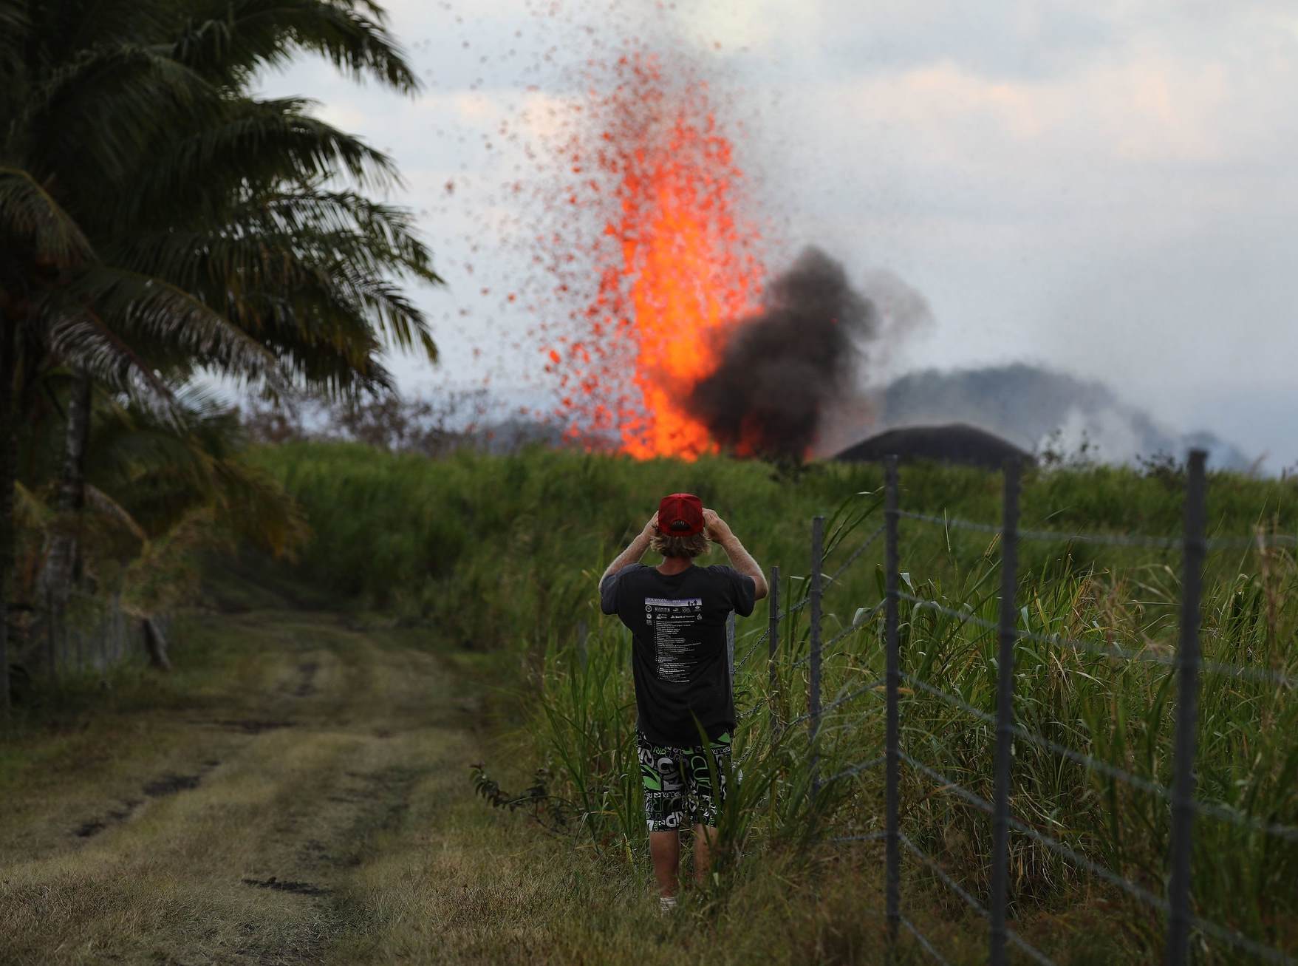
Resource : https://www.nytimes.com/2018/12/12/science/kilauea-hawaii-volcano-eruption.html

Slide 4
Goal:
The purpose of this project is providing an introduction study to predict the impact of volcanic ashes on water stream sources in Hawaii.
QUESTIONS:
1- where there might be a water pollution caused by ashes?
2- how many people will be affected who are living in the ash's zones?

Slide 5
DATA COLLECTION:
DEM (raster)
The ASTER Global Digital Elevation Model (GDEM) Version 3 (ASTGTM) provides a global digital elevation model (DEM) of land areas on Earth at a spatial resolution of 1 arc second (approximately 30-meter horizontal posting at the equator).
https://search.earthdata.nasa.gov/
Population (point shapefile)
2010 block census data for the Hawaii county. The total population was 185,079.
GISL data
Kilauea volcano (CSV)
Excel contain the name, longitude and latitude.
Google Earth

Slide 6
DATA COLLECTION:
State of Hawaii boundary (polygon shapefile)
Coastlines for the main eight Hawaiian Islands.
Source: USGS Digital Line Graphs, 1983 version. Extracted from USGS Digital Line Graphs by Office of Planning staff, 1988.
http://geoportal.hawaii.gov/datasets/045b1d5147634e2380566668e04094c6_3?orderBy=isle

Slide 7
Workflow:
Program:
python 2.7.16 and ArcGIS desktop 10.7.1
Files preparations:
A- Convert the location Volcano csv file to the point shapefile.
B- Select by attribute the Hawaii county from Hawaii state polygon shape file
C- Select by location the Hawaii county population from Hawaii state population shape file.
D- Mosaic the 6 DEM Raster that covered the Hawaii county.
Note: All the out puts saved to the geodatabase.

Slide 8
Workflow:
2) model the flow of water across a surface.
1- Fills sinks in a surface raster to remove small imperfections in the data.
2- Creates a raster of flow direction from each cell.
3- Creates a raster of accumulated flow into each cell.
4- Raster calculator: Calculate the Hawaii county streams by considering any flows with greater value than 2000 as stream.
5- convert Hawaii streams to feature (polyline feature class)
3) Create 30 Km and 45 Km buffer circle ranges around the Volcano and calculate the length of streams and total of the population inside those ranges.

Slide 9
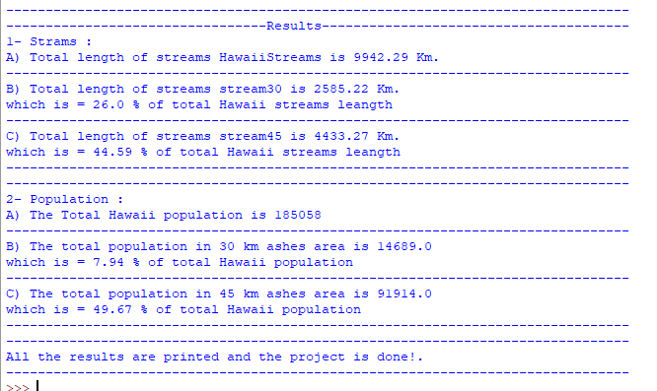
Results:

Slide 10
Maps

Slide 11
Conclusion:
People living within 45 km from Kilauea Volcano should be draw more attention, however, the people living 50~70km should also be informed and be award of the fact that they are also at risk from ashes blowing from the volcano end up contaminating their water resources.
Volcanic impacts on the oceans and marine life should be studied in this area.

Slide 12
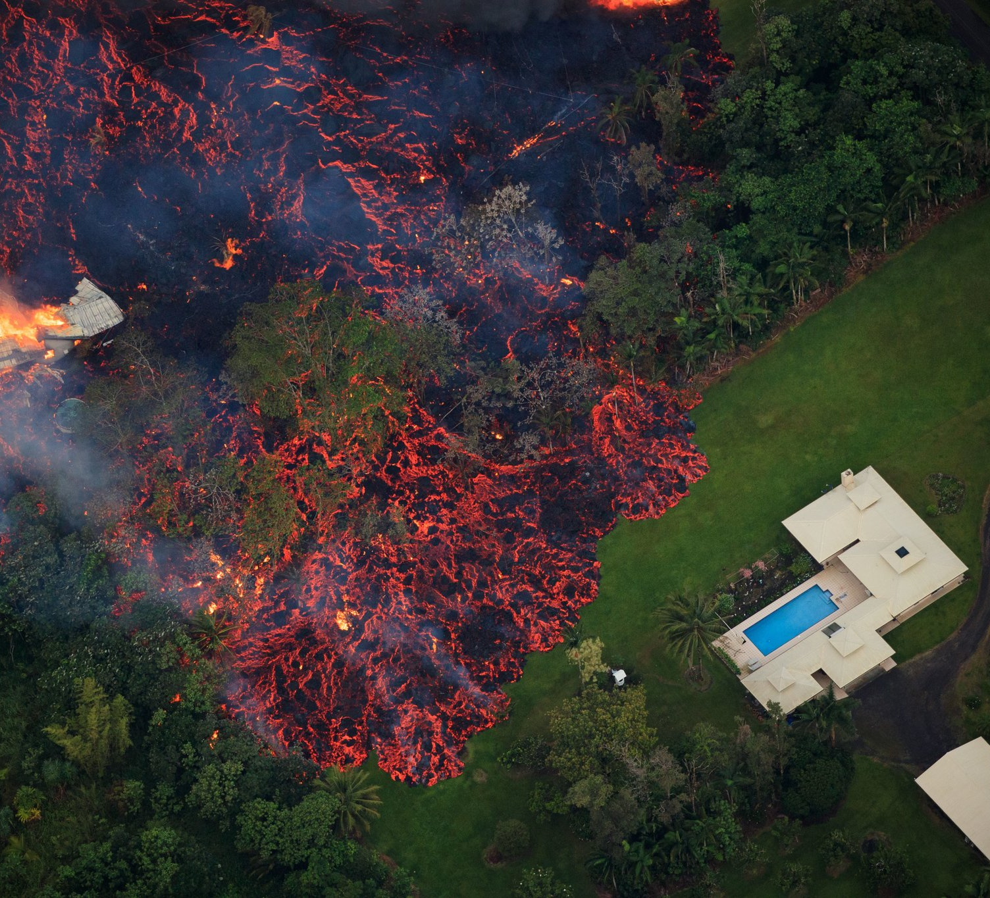
References:
C. Stewart, D.M. Johnston, G.S. Leonard, C.J. Horwell, T. Thordarson, S.J. Cronin, Contamination of water supplies by volcanic ashfall: A literature review and simple impact modelling, Journal of Volcanology and Geothermal Research,Volume 158, Issues 3–4, 2006, Pages 296-306, ISSN 0377-0273, https://doi.org/10.1016/j.jvolgeores.2006.07.002.
(http://www.sciencedirect.com/science/article/pii/S0377027306003179)
Volcano Hazards Program,https://volcanoes.usgs.gov/index.html

